Slide 1
Group 2
Final Project - Commuter Transportation Preferences

Slide 2
Presentation
Introduction and Selecting Data Sources - Ryan
Data Exploration Phase - Michael
Analysis Phase - Robert
Machine Learning Model - Joey

Slide 3
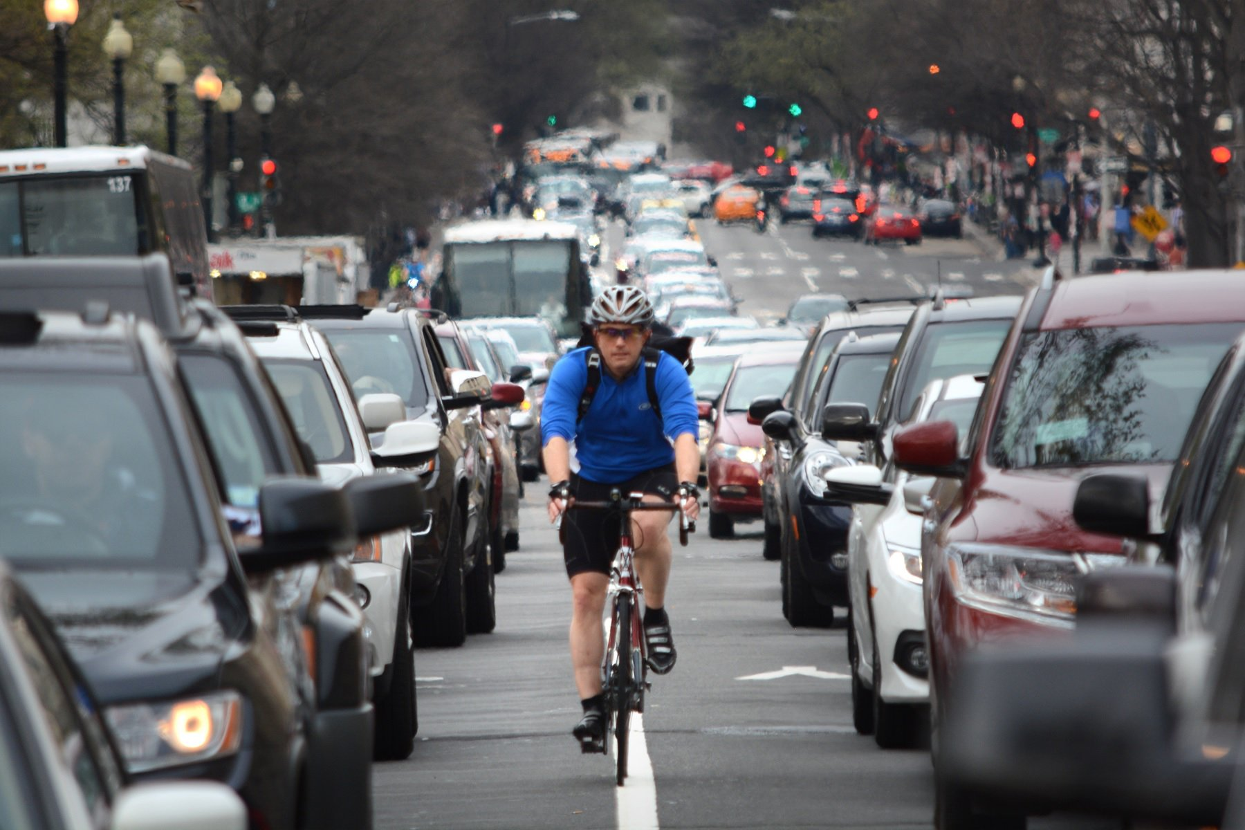
Selected Topic
Vehicle and Pedestrian Traffic Volume
Source: https://wtop.com/local/2017/05/many-people-really-bike-work-around-dc-surprising-stats/
Notes:
We chose to analyze vehicle and pedestrian traffic along with weather data was collected in Ramsey County Minnesota from June 2015 to September 2018.
For purposes of this presentation, when we say Pedestrians, we mean both bikers and walkers.

Slide 4
Why we selected this topic
We are interested in how weather, day of the week, time of year and holidays affected commuters’ preferred method of transportation.
Notes:
Why did we select this topic? We wanted to know what factors played a role in the varying levels of vehicle versus pedestrian traffic. Specifically, we looked at weather data (including temperature, cloudiness and precipitation), day of the week (individual days and also weekdays versus weekends), the time of year, and different holidays throughout the year, to see what effect these factors had on traffic volume.

Slide 5

Data Sources
Vehicle Traffic Data
Source: https://www.dot.state.mn.us/
I-94 Westbound Traffic, Ramsey County, MN
·
MN DoT ATR Station 301
·
Hourly traffic data 2012 - 2018
Notes:
Two datasets were used in our analysis.
The first dataset contained information on hourly traffic volume, hourly weather information, and holidays.
The second dataset contained information on pedestrian traffic on specific days.
Our vehicle traffic dataset, compiled by the Minnesota Department of Transportation, contained hourly Westbound traffic volume for Minnesota Department of Transportation Station 301, which is located roughly midway between Minneapolis and St. Paul, MN. The data was collected from October 2012 to September 2018.

Slide 6

Data Sources (cont’d)
Weather & Holiday Data
Source: https://openweathermap.org/api
OpenWeathermap
·
Temperature
·
Hourly traffic data 2012 - 2018
Notes:
The weather data was obtained from OpenWeathermap, and contained information on the following: average temperature, rainfall, snowfall, cloudcover, and columns for textual descriptions of the weather.
The holiday column contained information on national holidays, plus a regional holiday (MN State Fair)

Slide 7
Data Sources (cont’d)
Pedestrian Data
Source: https://www.dot.state.mn.us/
The pedestrian data used also came from a MN Dept. of Transportation dataset.
·
Walkers and Bikers in Ramsey County from 2014 - 2020
·
Lots of excess data
Notes:
The pedestrian data we used also came from the MN Dept. of Transportation, in a separate dataset.
This dataset contained information on walker and biker volume from all over the state of Minnesota from 2014 - 2020. It contained the number of pedestrians and cyclers that went through checkpoints each day. We used the two checkpoints in Ramsey County.
It also contained information we didn’t need for our analysis, such as the technology used to collect the data, the type of path the walkers and bikers used, and some basic weather data.

Slide 8
Questions we hope to answer with the data
How does commuter behavior change given the day of the week and time of year?
How do weather conditions affect commuter behavior?
Can we predict pedestrian traffic on a given day assuming vehicle traffic and weather conditions?
Notes:
Read questions aloud

Slide 9
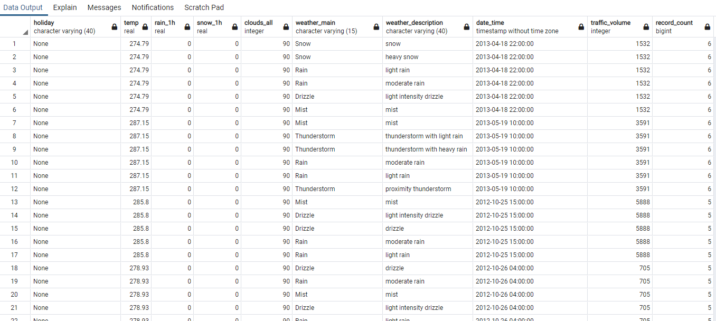
Data Exploration - Vehicle Traffic dataset
Some preliminary data exploration done in excel, with most of the data cleaning done in postgreSQL.
Found duplicated datetime values in vehicle table
Notes:
After briefly examining the datasets in excel to determine how many rows and columns, and what each column held, and seeing that temp was in Kelvin, rain and snow in mm per hour, and clouds a, we loaded the two raw datasets into a postgreSQL database and used pgAdmin to further explore, clean, and ultimately combine the datasets for the machine learning model. We first explored the raw_vehicle_traffic table, and found that while there should be 1 entry per date per hour, some date_times had up to six entris, with duplicate weather and traffic values and slightly differing descriptions. We dropped these descriptive columns and selected a distinct entry for each datetime and weather values. There were still a few datetimes with multiple entries and slightly different weather measurements. We averaged the weather measurements in those cases to get a single unique entry per datetime.

Slide 10
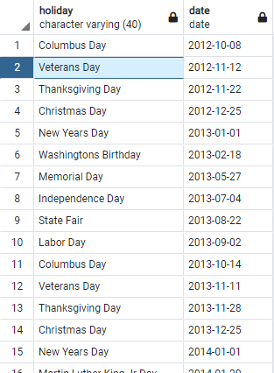
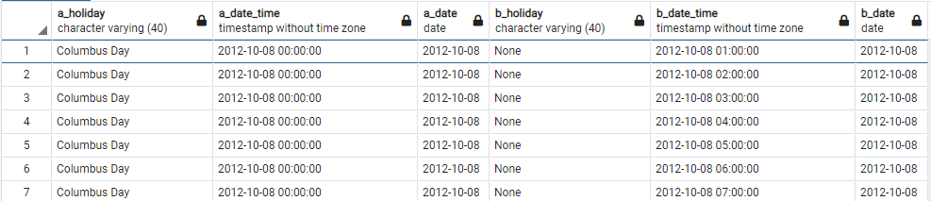
Data Exploration (cont’d)
Not all datetimes for holidays were correctly labelled.
Notes:
Next we found that for holidays, only 1 hour had the holiday labelled per day, instead of every hour in the same day, as you can see on the left where October 8 at Midnight is labelled Columbus day, while 1,2,3, etc are labelled ‘None’. To correct this, we dropped the holiday column from the vehicle traffic table and created a new holiday table with each holiday and the date, which could later be joined back to the rest of the data to apply the holiday label correctly to all corresponding dates.

Slide 11
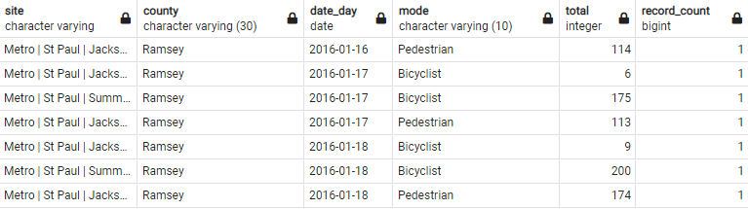
Data Exploration - Pedestrian Traffic Dataset
Notes:
In the raw bike-pedestrian table, unlike the vehicle set, there was only data on traffic per day, not per hour. There were several columns with metadata describing sites and technology used for data collection as well as some weather columns. We did not need this metadata nor the weather readings since we had more complete weather data from other table. In this dataset, found entries for multiple counties in Minnesota. When filtering to just Ramsey county, to match the location of the data in the vehicle dataset, we found Ramsey county had two sites, one north/south, one east/west, and separate entries for each site for pedestrian and bike traffic, but unlike the other dataset, there were no duplicate entries per date. Since we wanted a total for all non-motor-vehicle traffic in the area, we aggregated the totals for each site and mode of transportation for each day.

Slide 12
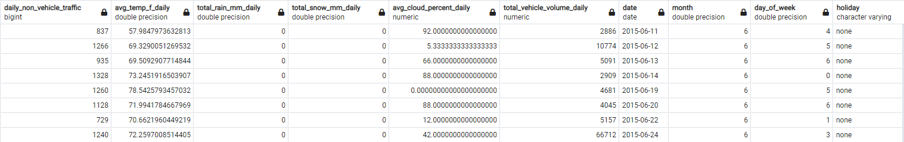
Combining the Data Sets
We joined the Vehicle, Pedestrian, and Holiday tables to create a dataset for analysis and for use in the machine learning model.
Notes:
Because the vehicle traffic table had entries for each hour while the pedestrian table only had entries for day, we had to create date column and group by date in the vehicle table, summing the rain, snow, and traffic for each day and getting an average temperature and cloud cover. We also converted the Kelvin temperature to Farehnheit, then joined the vehicle, pedestrian, and holiday tables to create a single dataset to use in the machine learning model. Since we were already adding a date column derived from the datetime at this step, we also added a day of week and month of year column extracted from the date as a preliminary part of feature engineering.

Slide 13



Analysis Phase
Notes:
Data analysis can take many shapes and forms. One of the tools we used as a team was to create visualizations that helped discover patterns, data anomalies, and prepare the data for the machine learning model. Matplotlib, Seaborn, and Tableau are all applications that can be used to create robust visualizations of our data.

Slide 14
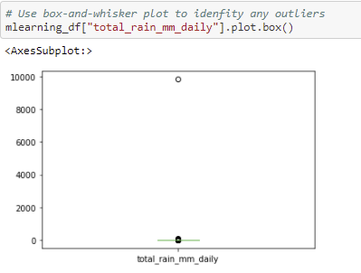
Analysis Phase (cont’d)
Outlier
Notes:
Initial analyses included several box and whisker plots. Here is an example of a box and whisker plot that shows the daily rainfall for the county we are examining. You can see that all of are data is clustered around a value slightly greater than 0, but one value is almost 10,000 mm of rainfall. This is clearly a bad data point and was removed from are dataset.

Slide 15
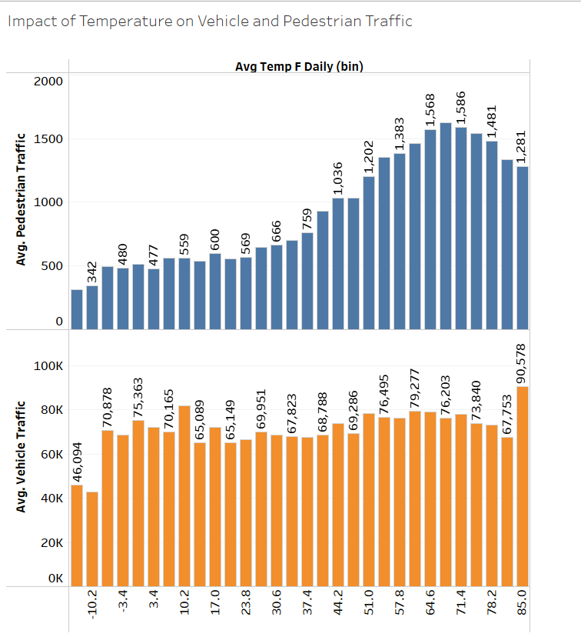
Analysis Phase (cont’d)
Temperature
Notes:
Given that we are trying to answer the impact that weather and vehicle traffic have on pedestrian traffic, it was only natural to create a visualization that showed the correlation between daily temperature and both vehicle and pedestrian traffic. As you can see, as the temperature rises, so does the average pedestrian traffic, while vehicle traffic rises suddenly at first, it eventually stays somewhat flat.

Slide 16
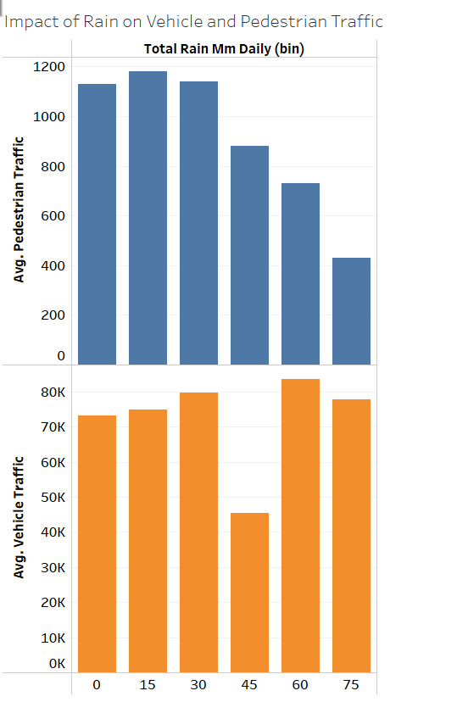
Analysis Phase (cont’d)
Rain
Notes:
Here is an example showing the effect that daily rain totals have on the two primary modes of mobility, vehicle and pedestrian traffic. The dataset had over 60 individual daily rain totals, so we used the process of grouping or binning the rain totals to simplify the visual representation. As you can see, pedestrian traffic tends to decrease with higher rain volumes, while except for one category, vehicle traffic stays between 70 and 85k.

Slide 17
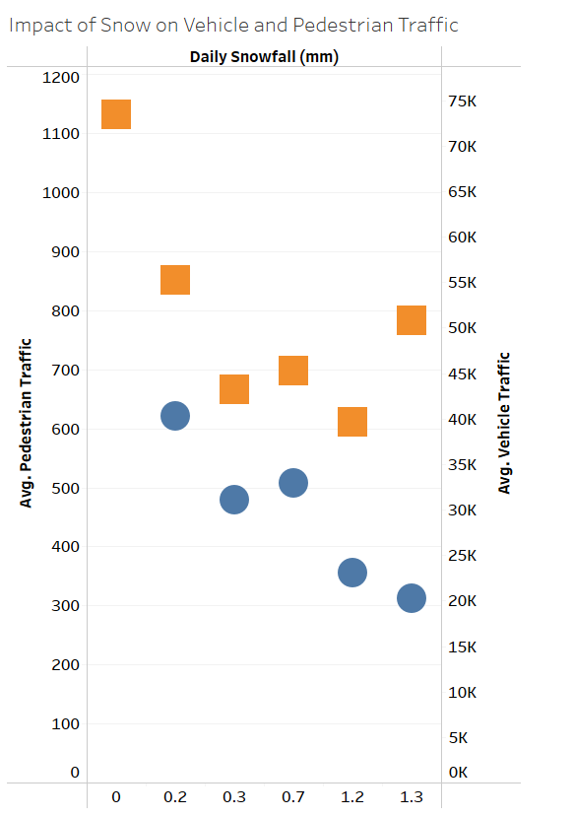
Analysis Phase (cont’d)
Snow
Notes:
Similar to the previous slide, this visualization shows the impact of snowfall on both vehicle and pedestrian traffic. Unlike rainfall, the snow totals were extremely limited and did not need to be grouped or placed into bins. As shown, both vehicle and pedestrian traffic decrease with an increase in snowfall except for an increase in vehicle traffic for the last snowfall totals.

Slide 18
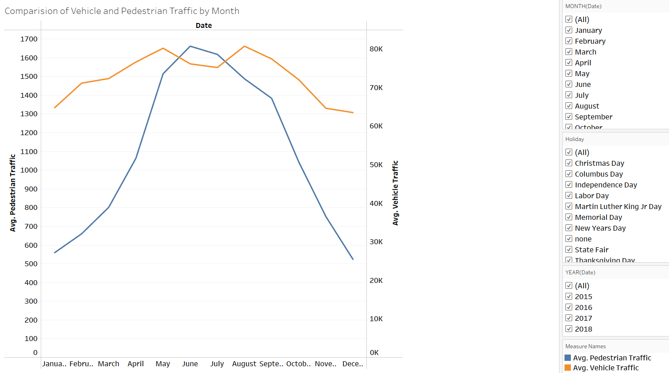
Analysis Phase (cont’d)
Month
Link to Tableau
Notes:
Given that we had looked at different weather conditions and the correlation they had to vehicle and pedestrian traffic, the next step was to look at the different times of the year. Particularly, what effect did the month of the year have on both vehicle and pedestrian traffic? The graphic being shown is interactive and can be filtered by year, month, and holiday as demonstrated when we click the attached link.

Slide 19
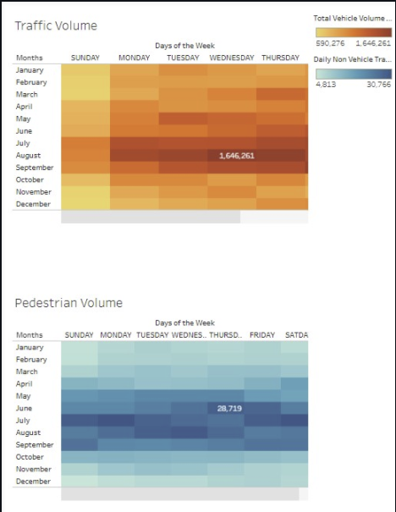
Analysis Phase (cont’d)
Notes:
Another data point that we wanted to examine was how does the day of the week impact both vehicle and pedestrian traffic volumes? From our heat map tables we can see that vehicle traffic concentrates during the week while pedestrian traffic stays steady with slight increases on the weekend.

Slide 20
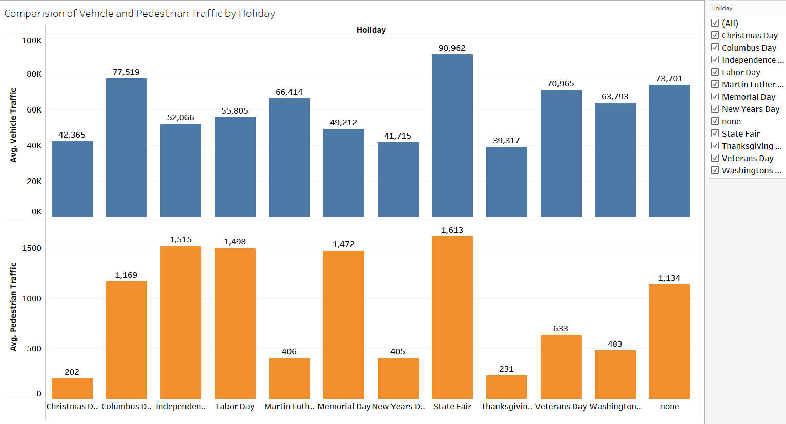
Analysis Phase (cont’d)
Holiday
Notes:
Finally, one of the last data points that we had to work with was the effect that a holiday had on both vehicle and pedestrian traffic. The result was varied, but one insight that was gained was that the holidays taking place during the warmer months had much greater pedestrian traffic than holidays during the colder months. While all the insights created by the analyses of the data through visualizations might seem reasonable to conclude, we still needed to perform our machine learning modal to gain a complete picture of the datasets.

Slide 21
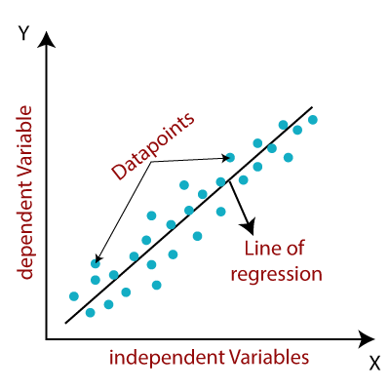
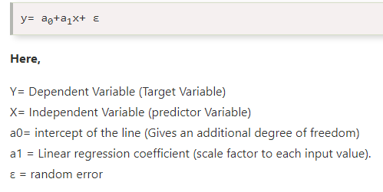
Machine Learning Model
Linear Regression
Understanding relationship between input and output variables
Input and output are numeric values
Source: https://www.javatpoint.com/linear-regression-in-machine-learning
Source: https://www.javatpoint.com/linear-regression-in-machine-learning
Notes:
Our team felt the optimal model selection for our dataset was a Linear Regression model. It is easier to use compared to a deep learning model and predicts continuous variables, which is what our target variable is.

Slide 22

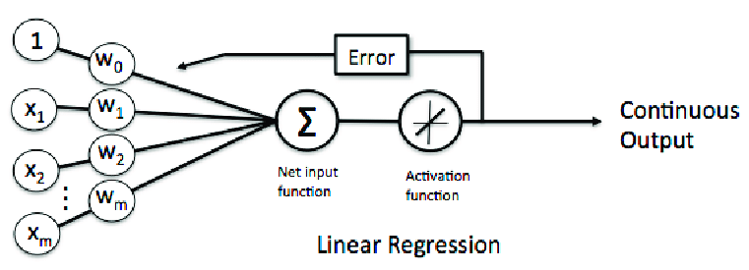
Machine Learning Model (cont’d)
Limitations
Cannot predict discrete values
Sensitive to outliers
Prone to underfitting
Benefits
Can predict continuous values
Linearity & simple implementation
Reduces overfitting by regularization
Source: https://www.researchgate.net/figure/Machine-learning-linear-regression_fig1_328948591
Notes:
Several benefits of linear regression model is that it’s an easy algorithm to implement, interpret, and efficiently train the model.

Slide 23
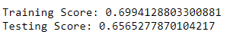
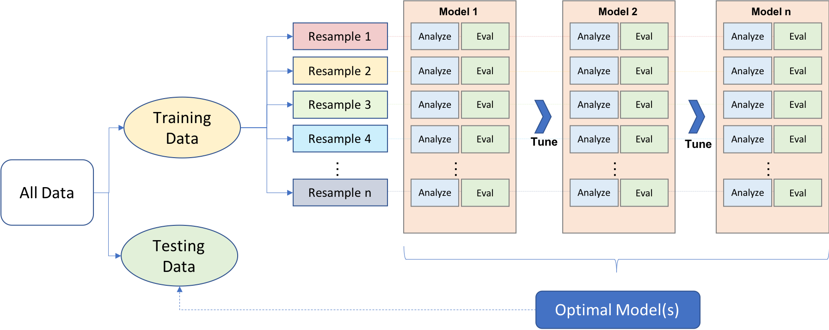
Initial Machine Learning Model
Initial Score
Make dataset more compatible with model
Dropped ‘Date’ column
Dropped extreme outlier
Convert ‘Holiday’ string values into integers
Grouped by ‘holiday’ and ‘none’
Converted labels into integers
Scale the Data
Compared scaled and unscaled data
Source: https://elitedatascience.com/machine-learning-algorithms
Notes:
Once our initial Machine Learning model connected to our SQL database using Python Pandas, we began preprocessing the data to make it more compatible with the model. As Michael mentioned, several columns were dropped and converted to accomplish model compatibility. We also scaled the data and ran the machine learning model over scaled and unscaled data. We discovered scaling our data did not affect our model’s R-squared score. Since our model is linear regression a confusion matrix is not necessary for this analysis.
We then tested the accuracy of our machine learning model by using SciKit-Learn to separate our dataset into a training set with 75% of the records and a testing set of the remaining 25% of records. We trained the model on the training set by giving the model both the values for the input features, such as rain, snow, temperature, as well as the true outcome values for Pedestrian traffic. The model used the input and output values to calculate a weighted coeffecient for each feature. Then the model was given those inputs and had it predict the pedestrian traffic outcome by applying the coefficients to the features. Our initial model had an R-squared score of .6565, meaning future data has a 65.65% chance of fitting the linear regression model.

Slide 24
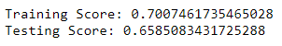

Optimized Machine Learning Model
Optimized Score
Further Feature Engineering and Selection Experimenting
Can model’s accuracy be improved?
Train model on new features.
Keep feature change if accuracy improved.
Optimized R-squared Score: 65.85%
Included all initial features
Left each holiday value in place
Grouped days into weekday or weekend
Source: https://realpython.com/train-test-split-python-data/
Notes:
As Robert mentioned, we experimented with further feature engineering and selection to determine if the accuracy score of our model could be improved.
Ultimately, the model performed best when all the initial features were included, each holiday in the holiday column was left in place, and the day of week was grouped into weekday or weekend. With this feature set, the model had the highest R-squared score at .6585, meaning there’s a 65.85% probability that future data points fitting the linear regression model.

Slide 25
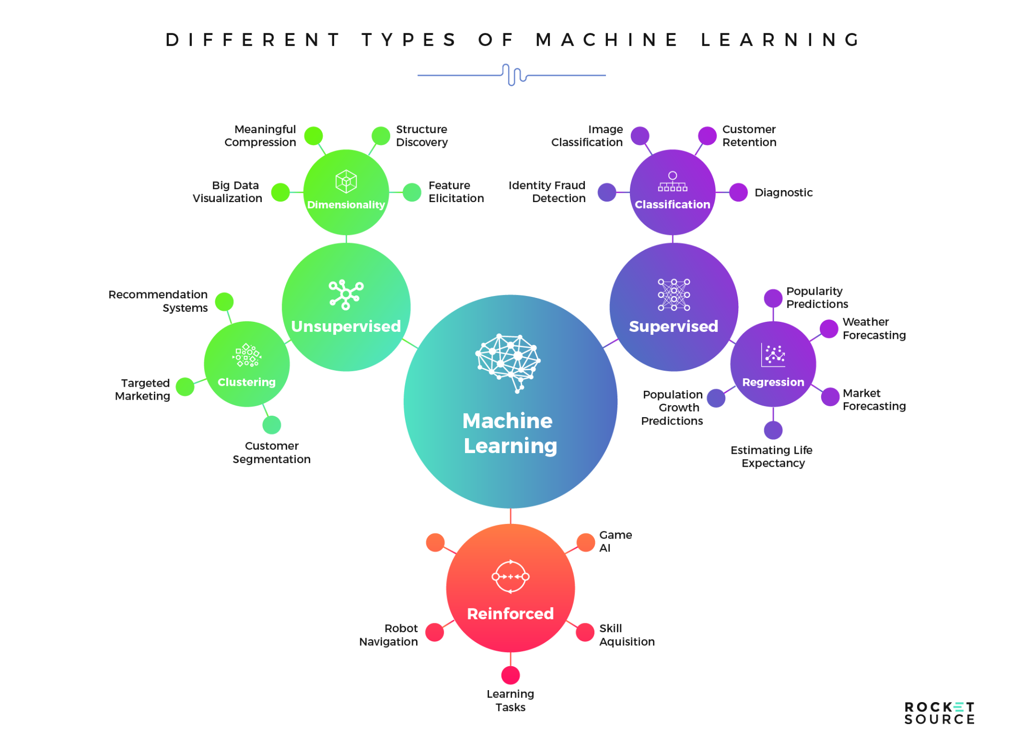
What we would change
Utilize a different Machine Learning model
Minimizing the reduction of data rows
Condensing 40,000+ rows of data to ~1,000
Collect more data
Notes:
For future analysis our team would incorporating more data into our analysis, such as hours. We did have to aggregate the traffic column and condense our date time column in the initial datasets. This resulted in initial starting with 40,000+ rows of data to condensing it down to about 1,000 rows. Again, our team would aim to collect more data for future analysis.

Slide 26

Future Analysis
Source: https://realpython.com/train-test-split-python-data/
Obtain additional records
From same dataset source
Add additional combination features
New datasets
Comparing accessibility to public transportation
Asking new questions
How does gas prices affect commuter habits?
Notes:
To improve the model going forward beyond the scope of this project, we could obtain more records gathered from the same sources used for this set. We could also look to add more features not available in this dataset, such as data relating to access to public transportation in the area, as that could affect how people choose to commute. Lastly, we would also ask additional questions we hope to answer with the data such as how does gas prices affect commuter habits?

